Slide 1
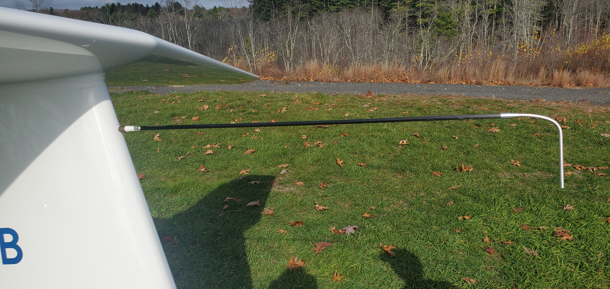
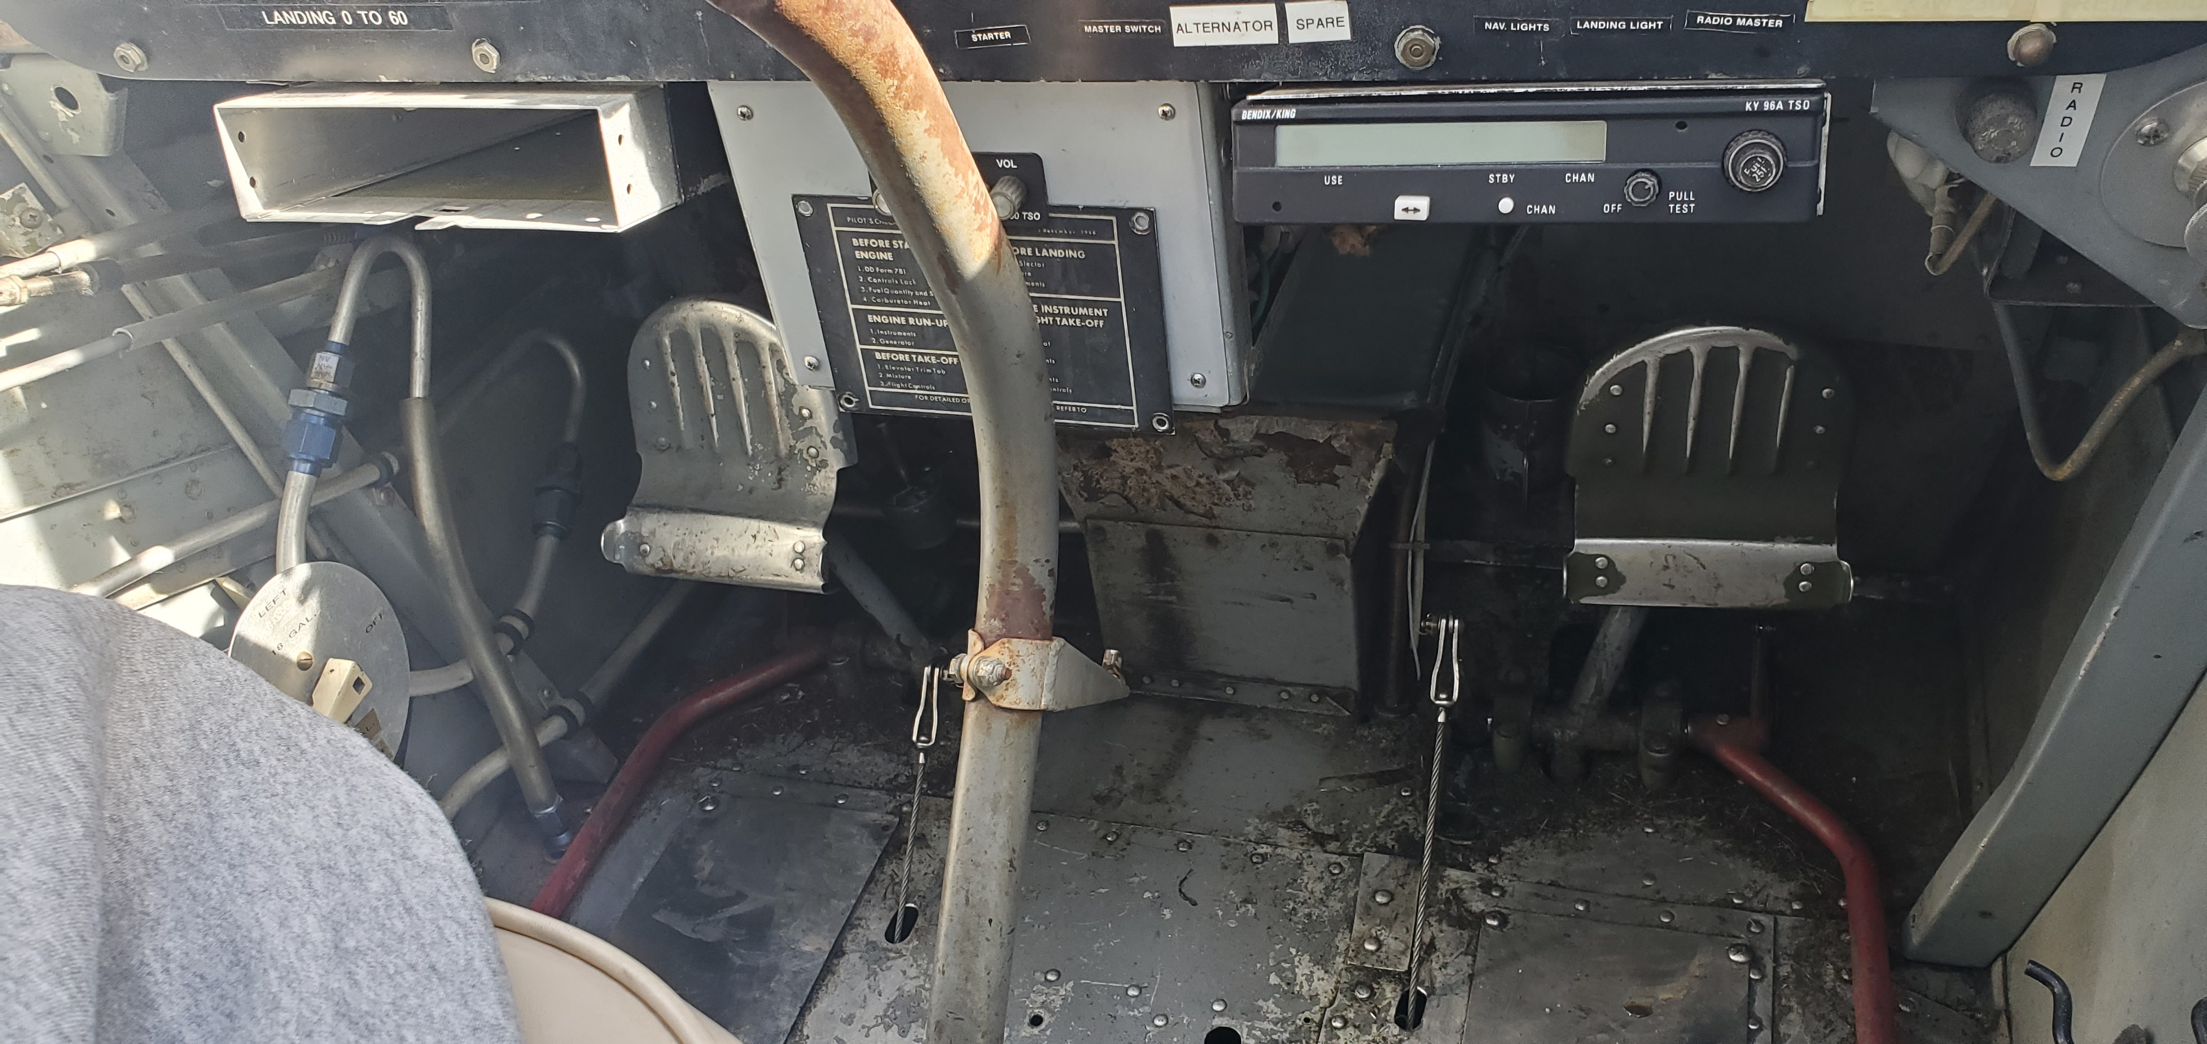
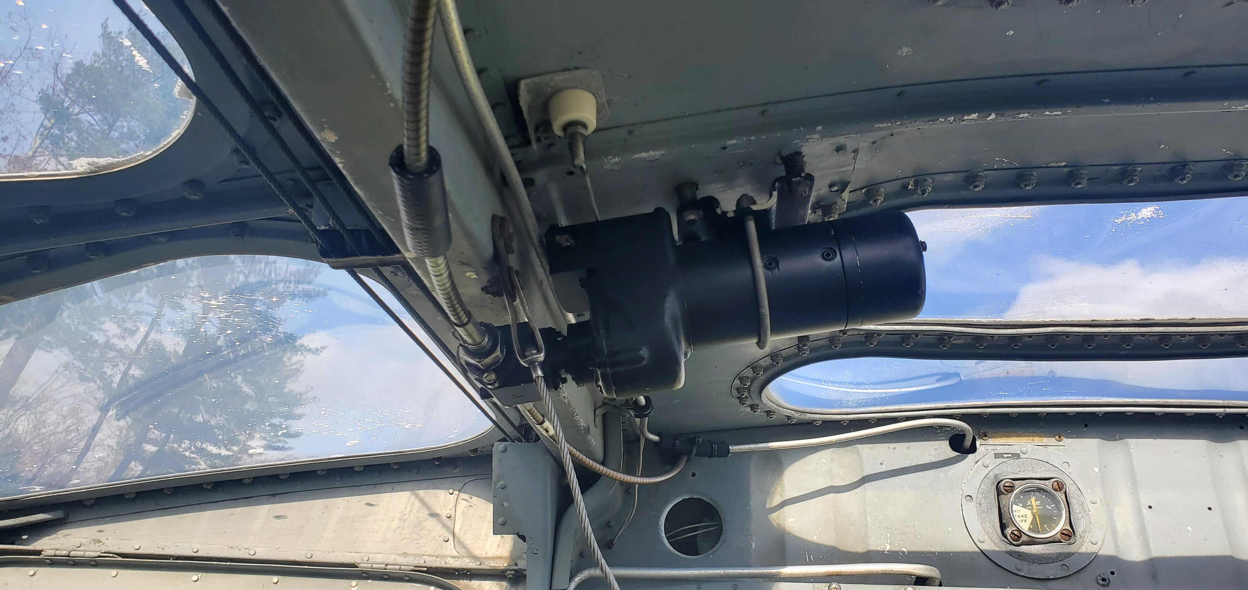
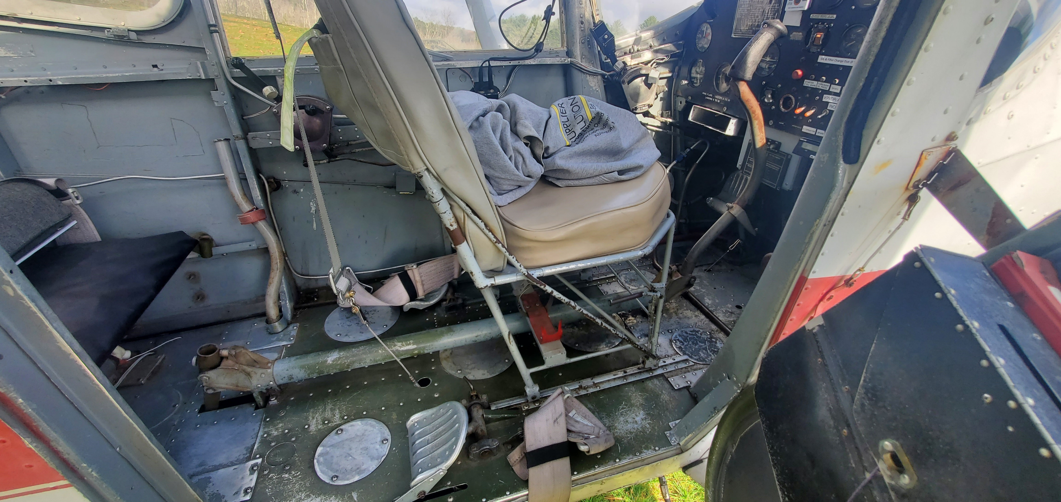
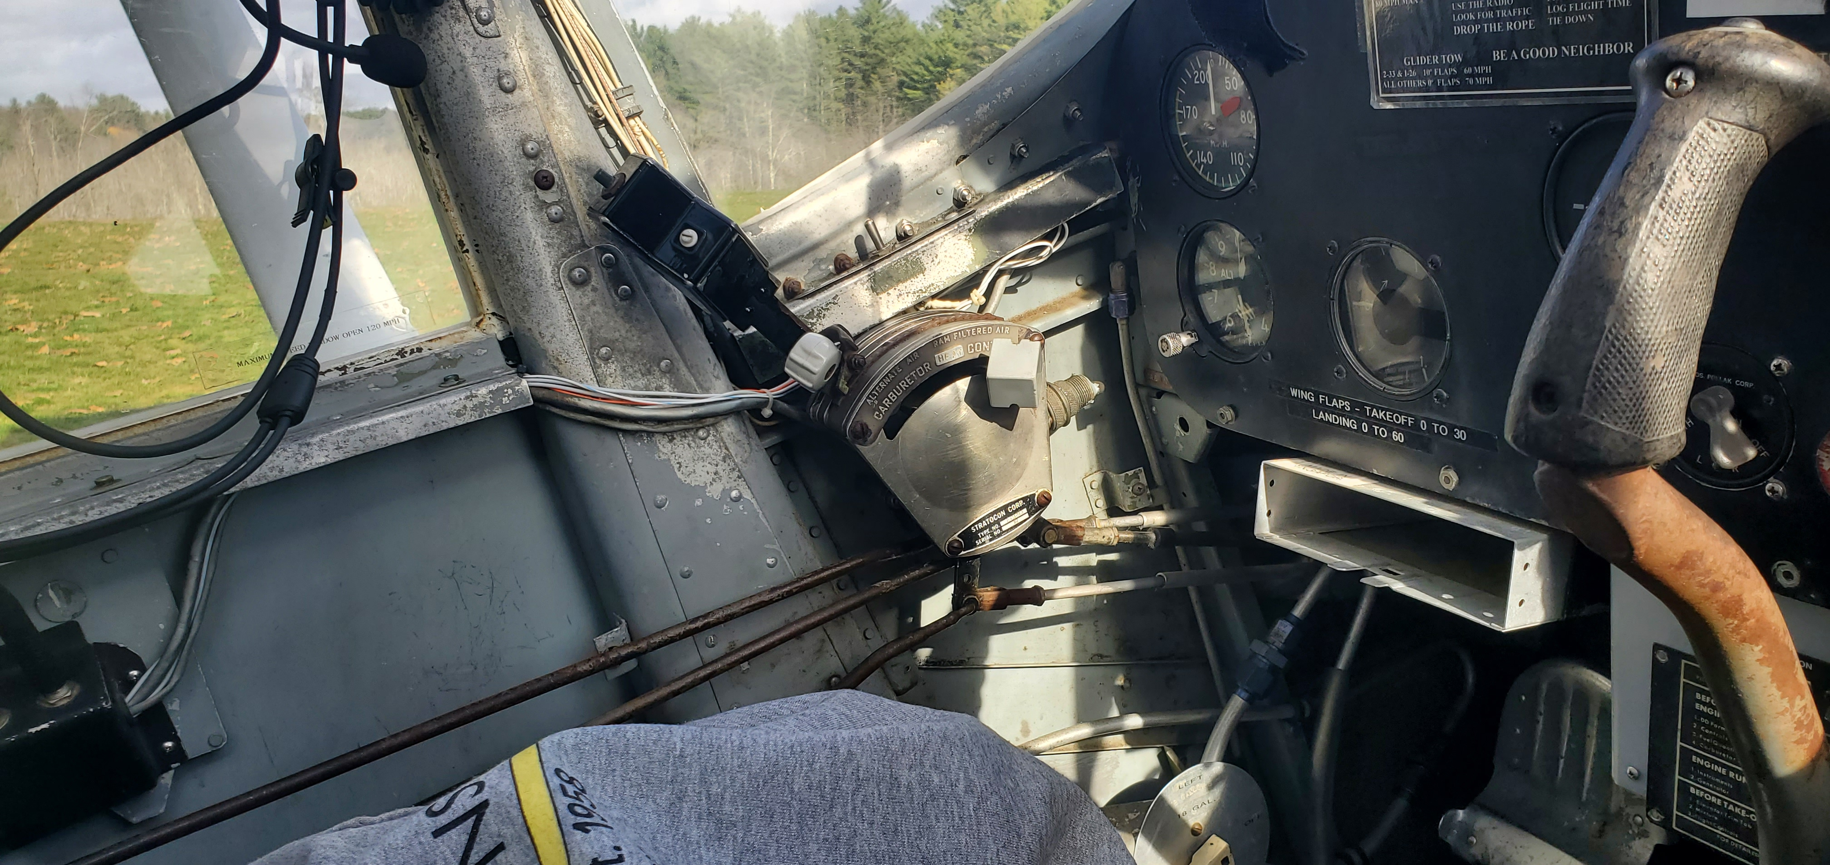

Slide 2
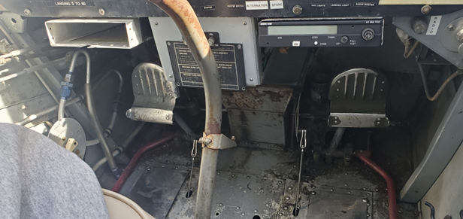
Rudder pedal
(can move forward/back (rudder) or tilt (brakes))
Pedals attached to flexible cables

Slide 3
Flap control cable
Flap Motor
^ Aileron cables

Slide 4
Control rods linked to levers open/close valves

